Slide 1
Fines and the Impact of the Recent NSW Supreme Court Case
Samantha Lee, Senior Solicitor, Redfern Legal Centre Timothy Smartt, Barrister at Tenth Floor Chambers

Slide 3
Outline
COVID and the NSW Public Health Act 2010
Stats & stories
The judgement
What does it mean for the future
Questions and further resources
RESOURCES: www.rlc.org.au/training/resources/fines

Slide 4
25 January 2020

Slide 5
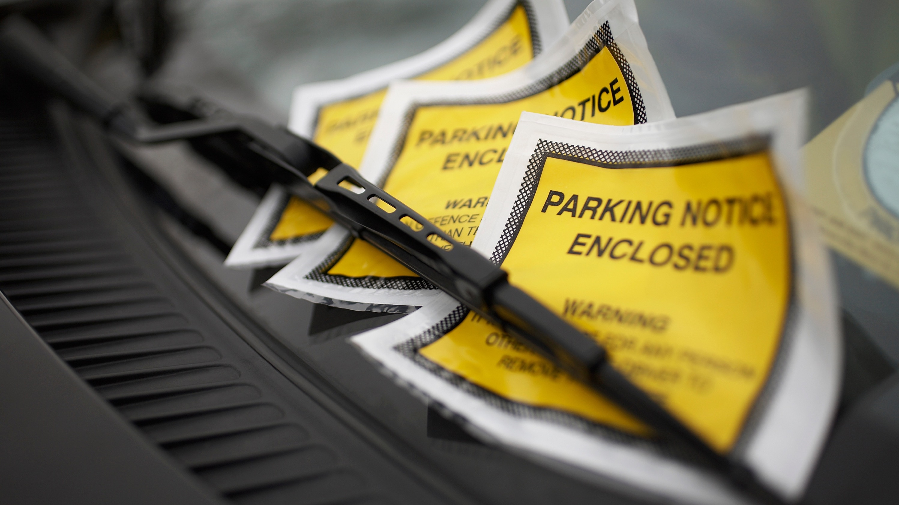
'THE COVID FINE'
ON-THE-SPOT FINES​
46 TYPES OF COVID FINES
STRICT LIABILITY ​
ELEMENTS OF THE OFFENCE ARE NARROW
AMOUNT IS LIMITED
RULES STAY THE SAME​

Slide 6
PU
s.10 - Public Health Act 2010 (NSW)
Offence not to comply with Ministerial direction
A person who:
(a) is subject to a direction under section 7, 8 or 9, and
(b) has notice of the direction,
must not, without reasonable excuse, fail to comply with the direction.
TOO COMPLEX
REASONABLE EXCUSE WAS A MOVING BEAST

Slide 7
Directions located in the PHO
21 Different PHOs
Hundreds of directions

Slide 9
Rules changing rapidly
15 March 2020 - first public health order
By 31 January 2022 - 266 principal and amending public
health orders had been issued
An average of an order every 2.5 days for almost 2 years
Source: NSW Ombudsman, The COVID Pandemic, Second Report, 2 September 2022

Slide 11
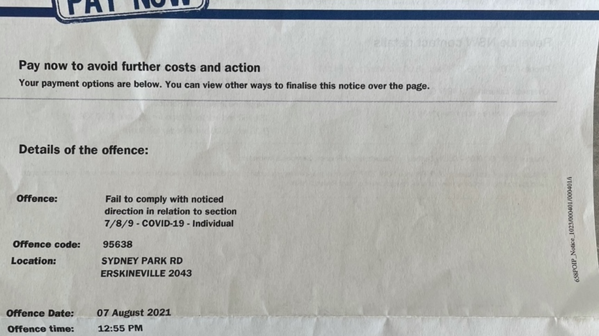
No mention of s.10 or PH Act

Slide 12
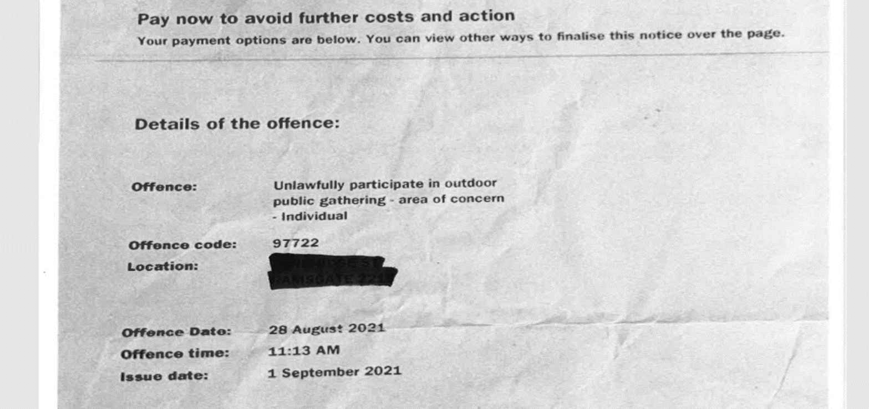
No mention of s.10 or PH Act

Slide 13
The Stats
62,074 fines issued - value of $56,540,740
15,133 have been paid - value of $13,479,080
Total court elections: 3,000
Total requests for review: 9,227
Total fines withdrawn: 1,288
Source: statistics from Revenue NSW: FY 2022/23, 2021/22, 2020/21,2019/20.

Slide 14
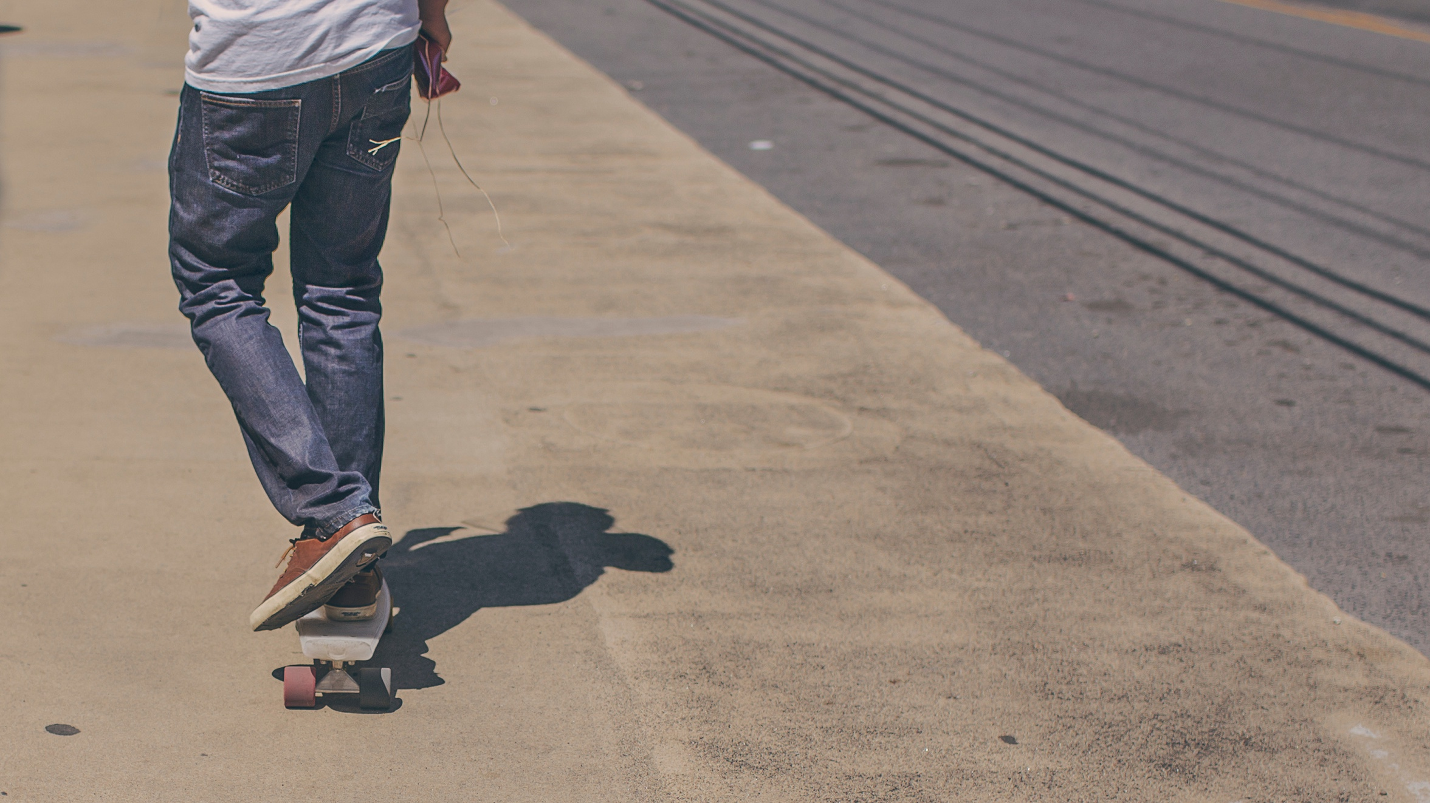
A value of $2,365,360 fines issued to children
Source: Budget Estimates, NSW Parliament, Portfolio Committee No.1 - Premier and Finance, 26 August 2022 .

Slide 15
July, Aug, Sept 2021
49,688 fines issued
Total value $45,895,180
74 public health orders passed
THE PEAK
Source: NSW Revenue, data and statistics, COVID-19 offences
NSW Ombudsman, 'The COVID-19 Pandemic: second report, 7 September 2022

Slide 16
3,843 fines issued to children
17 children issued with a $5,000 fine
39 children issued with a $3,000 fine
1,659 children issued with a $1,000 fine
Source: Budget Estimates, NSW Parliament, Portfolio Committee No.1 - Premier and Finance, 26 August 2022 .

Slide 18
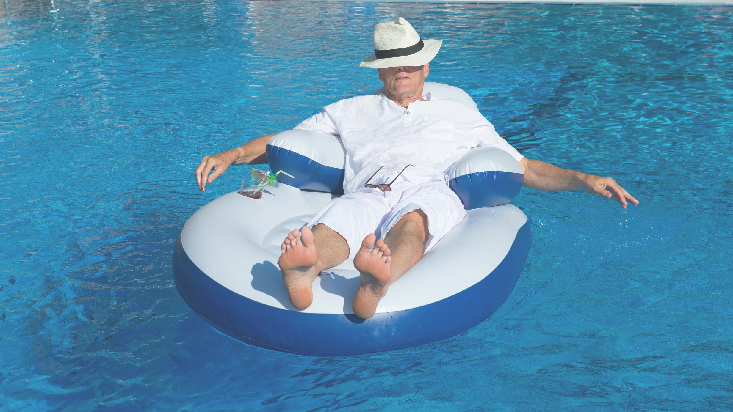
THE LEAST NUMBER OF COVID FINES ISSUED IN SOCIO-ECONOMICALLY ADVANTAGED SUBURBS IN NSW
Source: NSW Ombudsman, The COVID Pandemic, Second Report, 2 September 2022

Slide 19
Revenue NSW
no cost
fine put on hold
paper-based
Local Court
no longer a fine
possible criminal record
court can increase penalty
unknown offence

Slide 20
Revenue NSW
Applying law incorrectly
Fine too complex
Making wrong decisions

Slide 21
Rohan’s Story
The law
Allowed exercise and/or outdoor recreation in local government area or no further than 10km from home. Can be with one other person.
Review 1: "NSW Police officer advised you were in breach of PHO. The Minister directs that a person must not, without reasonable excuse, be away from the persons place of residence."
Review 2: "At time of the offence you resided at XXXX, Newtown which is located within the Inner West LGA. However, Sydney Park, Alexandria, is located in the City of Sydney LGA and therefore not permitted under the PHO for exercise."
Lodged case in Supreme Court:

Slide 22
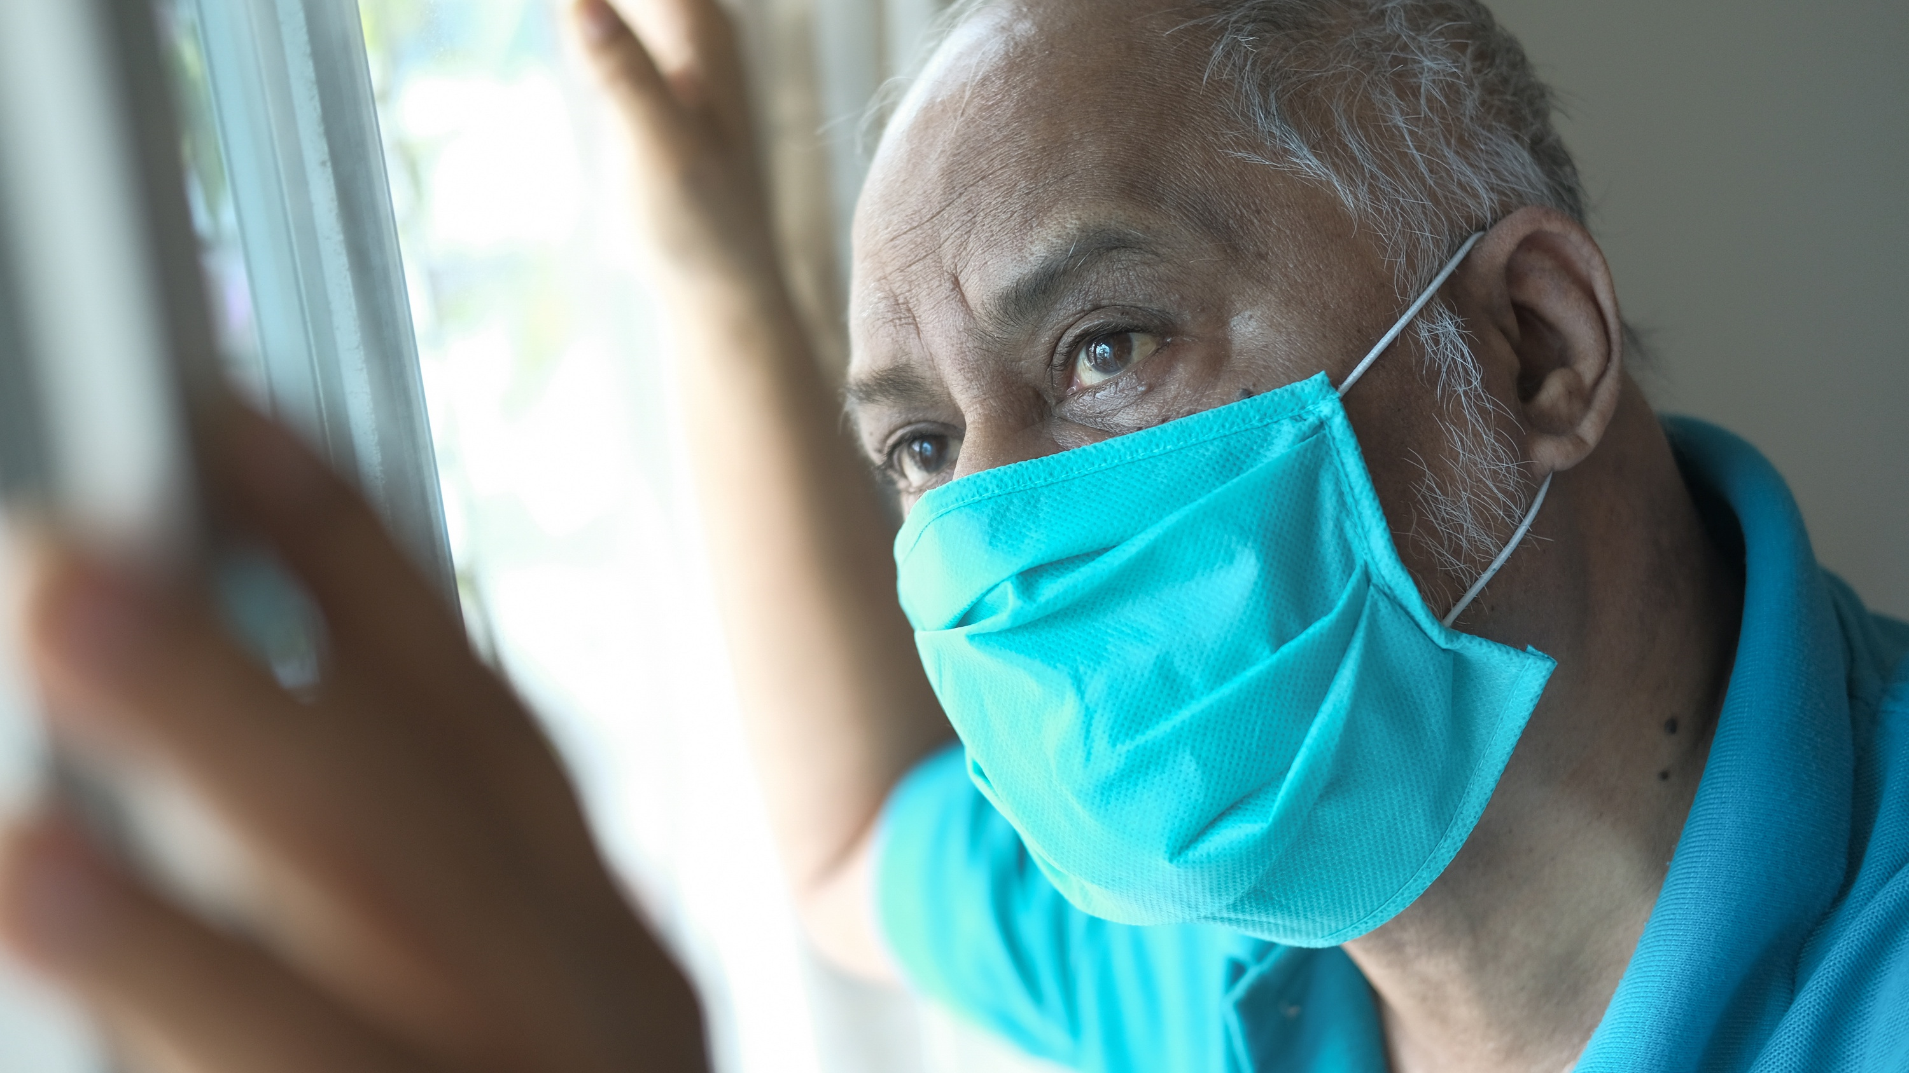
The stories on the ground

Slide 25
s.20 Fines Act 1996 (NSW)
“specify”
“unambiguously identified”
"to the effect that"
Law Part Code
s 12 Criminal Procedure Act 1986 (NSW)

Slide 26
THE JUDGMENT
Payment incentive
Amount in PN is different to amount imposed by court
Review requires an understanding of offence
Punitive character of PN
The phrase "to the effect that" does not alter the requirement that the PN offence must be "specified"
Law Code not enough
Short offence description was insufficient to meet s.20 Fines Act

Slide 27
What does the Supreme Court case mean for future penalty notices?

Slide 28
4. Questions and further resources
Samantha Lee, Senior Solicitor, Redfern Legal Centre Timothy Smartt, Barrister at Tenth Floor Chambers
RESOURCES: www.rlc.org.au/training/resources/fines

Slide 29
Before You Go
Your feedback helps us improve our training.
Please stay with us for another 30 seconds…
Training: rlc.org.au/what-we-do/training
Enquiries: Nick Manning education@rlc.org.au
This webinar is a guide to the law in Australia. It is not a substitute for legal advice. If you have a legal problem, seek legal advice from a legal centre or Legal Aid.

